Slide 1
Lecture 17

Slide 2
Lecture 17 objectives
Understand and describe common biological macromolecules
Understand and describe how structure relates to function
Understand and describe structure and function of complex macromolecules (containing more than 1 type of macromolecule)

Slide 3
Common biological macromolecules
The (almost) universal macromolecules in nature are:

Slide 4
Nucleic acids
Nucleic acids are:
Common examples:
Monomeric unit:
Polymeric unit:

Slide 5
Nucleic acids
Nucleic acid functions:
Nucleotide functions:

Slide 6
Nucleic acids
Nucleic acid monomeric units joined by ______ bond.
A. Peptide
B. Glycosidic
C. Phosphodiester
D. Ester

Slide 7
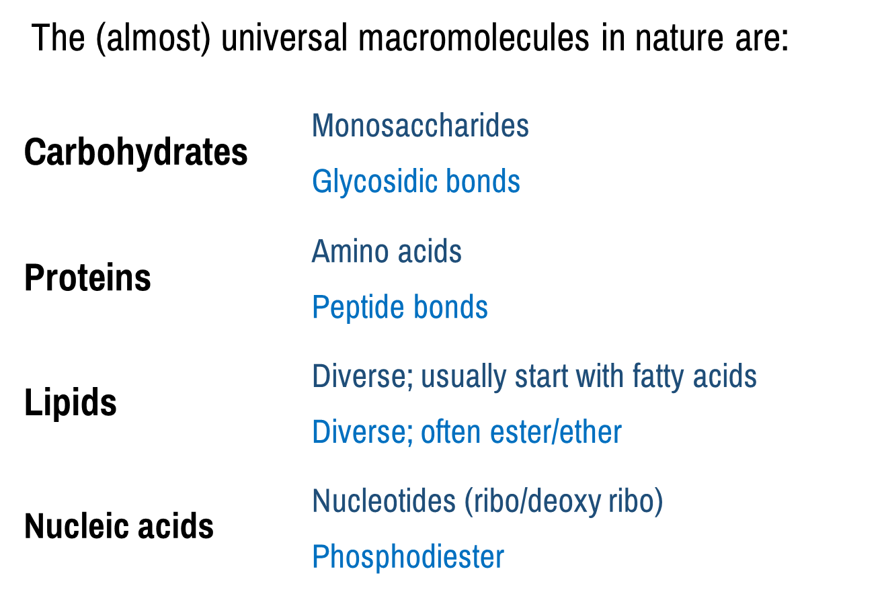
Common biological macromolecules
Common principles?

Slide 8
Functions of biological macromolecules
Function?
Function?
Common principle?
Function?

Slide 9
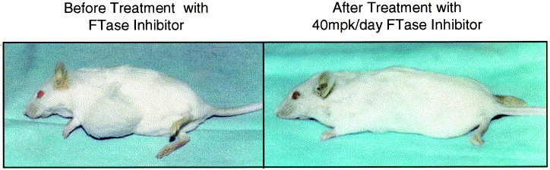
Mixing biological macromolecules
Cell cycle
Farnesyl transferase
Ras
Ras
doi: 10.1016/S0304-419X(99)00007-4

Slide 10
Mixing biological macromolecules
Galactoceramides
Myelin
Glycosylation
Pathogen recognition, immunity
LPS
Cartilage
Protein sorting
Glycosylation
Immunity
Common principle?

Slide 11
Functions of biological macromolecules
Protein
Amino acids
Functions?
Functions?
Carbohydrates
Monosaccharides
Functions?
Functions?
Common principle?
Lipids
Fatty acids
Functions?
Functions?
Nucleic acids
Nucleotides
Functions?
Functions?

Slide 12
Common biological macromolecules
Common principles?
Other examples?

